Slide 1
Management Information System (MIS Software)
nhp.mowr.gov.in
Module 4
NATIONAL HYDROLOGY PROJECT
GOVERNMENT OF INDIA, MINISTRY OF JAL SHAKTI
DEPARTMENT OF WATER RESOURCES, RD & GR

Slide 2
TODAY’S SESSION
Hydrological Information System Management
Purpose Driven Study (PDS)
PMU Staff Management
Reports
Live Demonstration
Q&A Session
Vendor Management
Modeller Management
Purpose Driven Study (PDS)
PMU Staff Management
KEY FOCUS ON

Slide 3
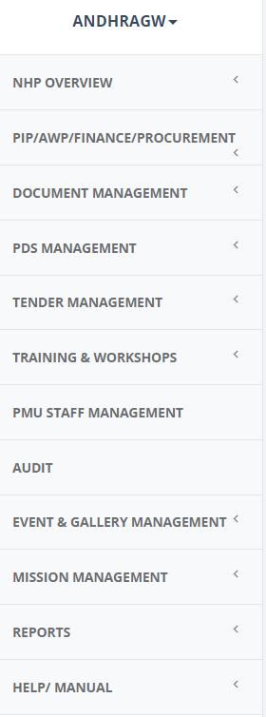
MIS FEATURES
Project Dashboard
Finance Management - Expenditure
Procurement Management
Hydrological Information System Management
Document Management
Purpose Driven Study (PDS)
Tender Management
Training & workshop Management
Audit
PMU Staff Management
Reports
Help/ Manuals Bulletins

Slide 4
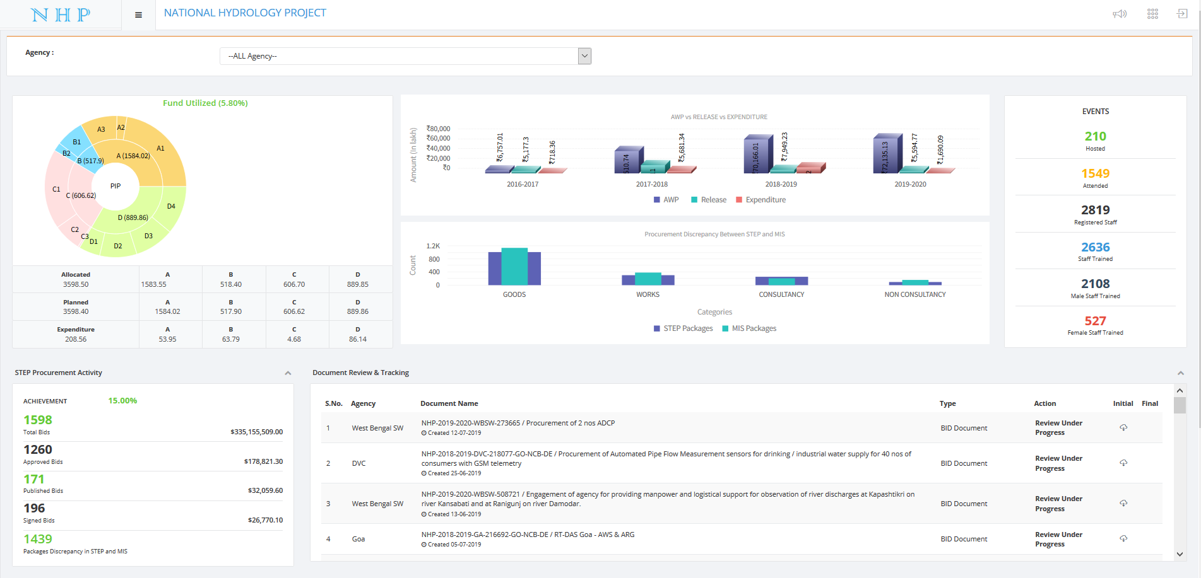
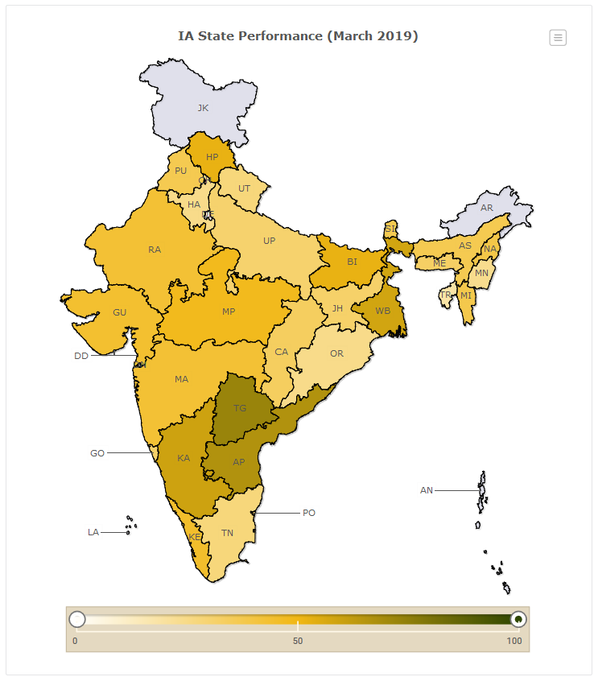
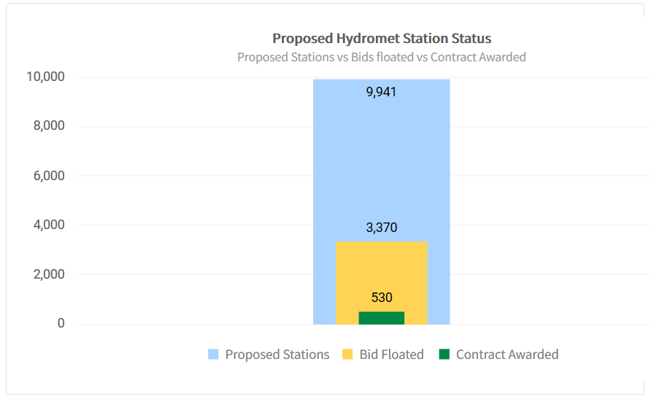
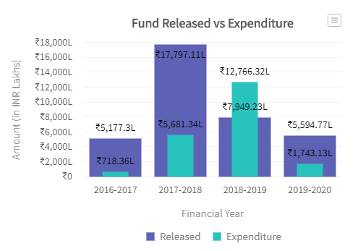
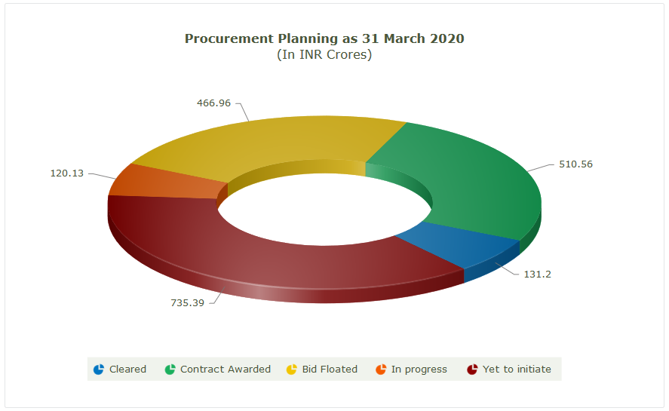
PROJECT DASHBOARD

Slide 5
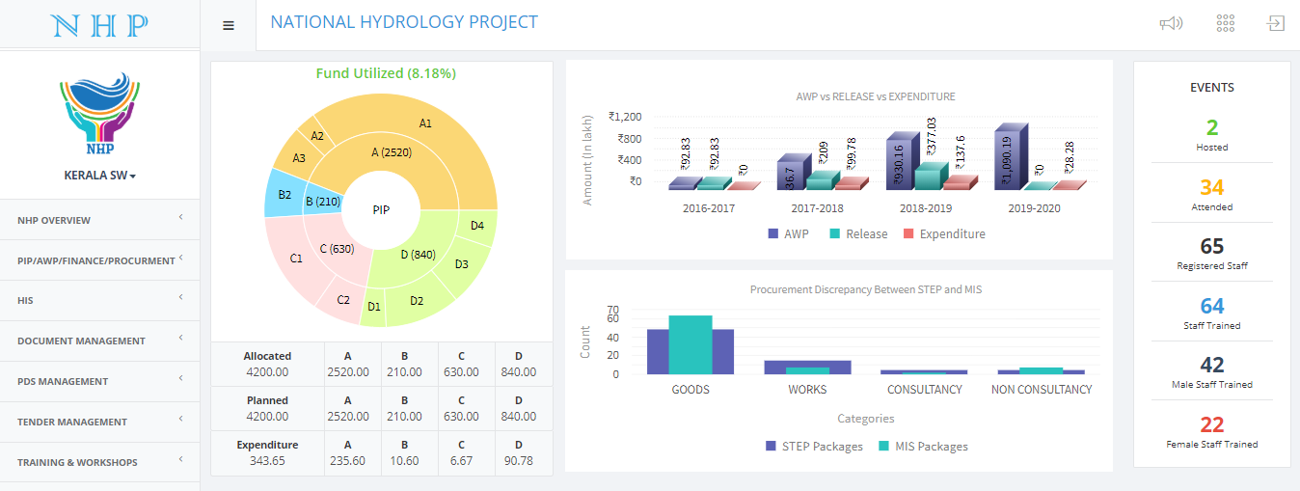
AGENCY DASHBOARD

Slide 6
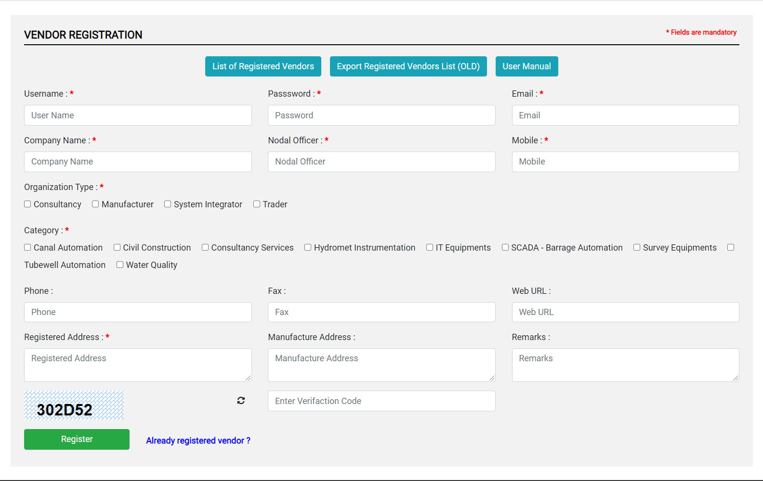
HIS – VENDOR REGISTRATION

Slide 7
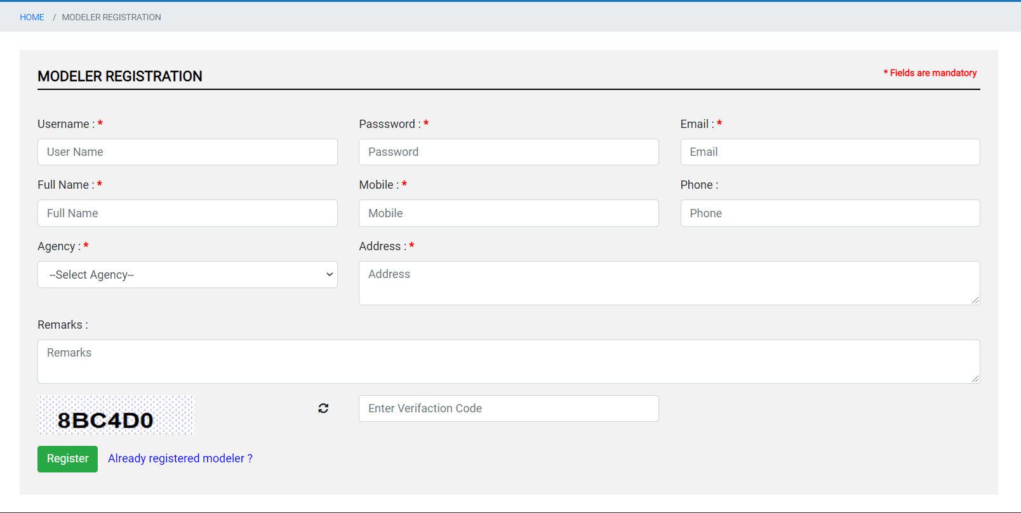
HIS – MODELLER REGISTRATION

Slide 8
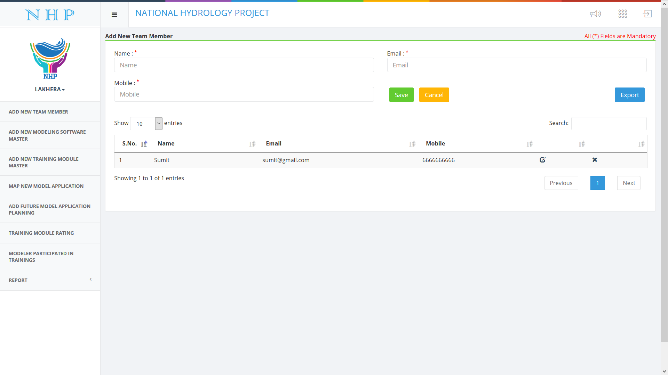
MODELLER - ADD NEW TEAM MEMBER

Slide 9
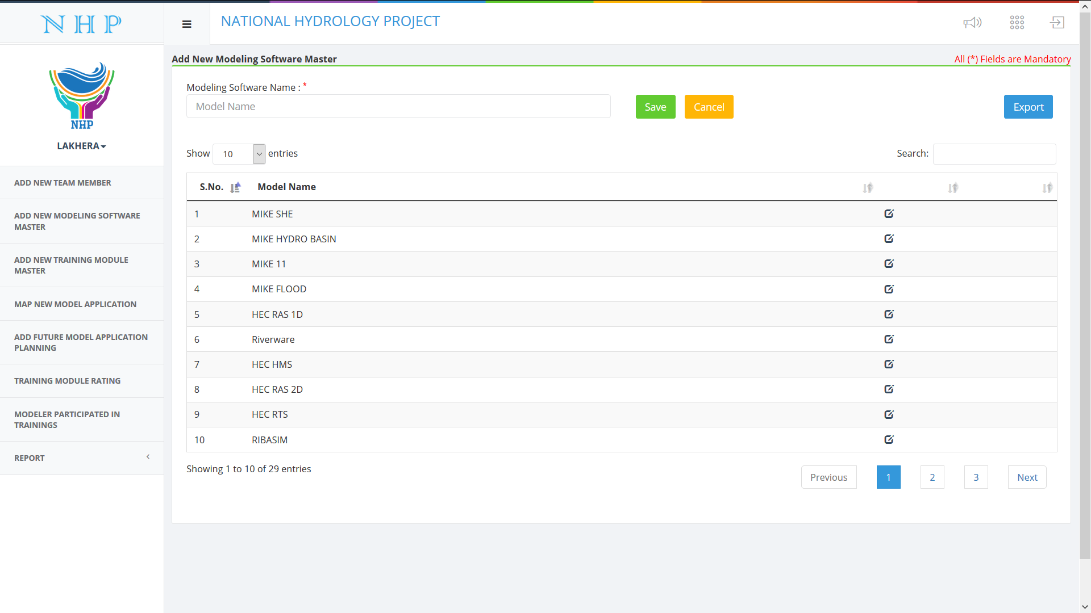
MODELLER - ADD NEW MODELLING SOFTWARE MASTER

Slide 10
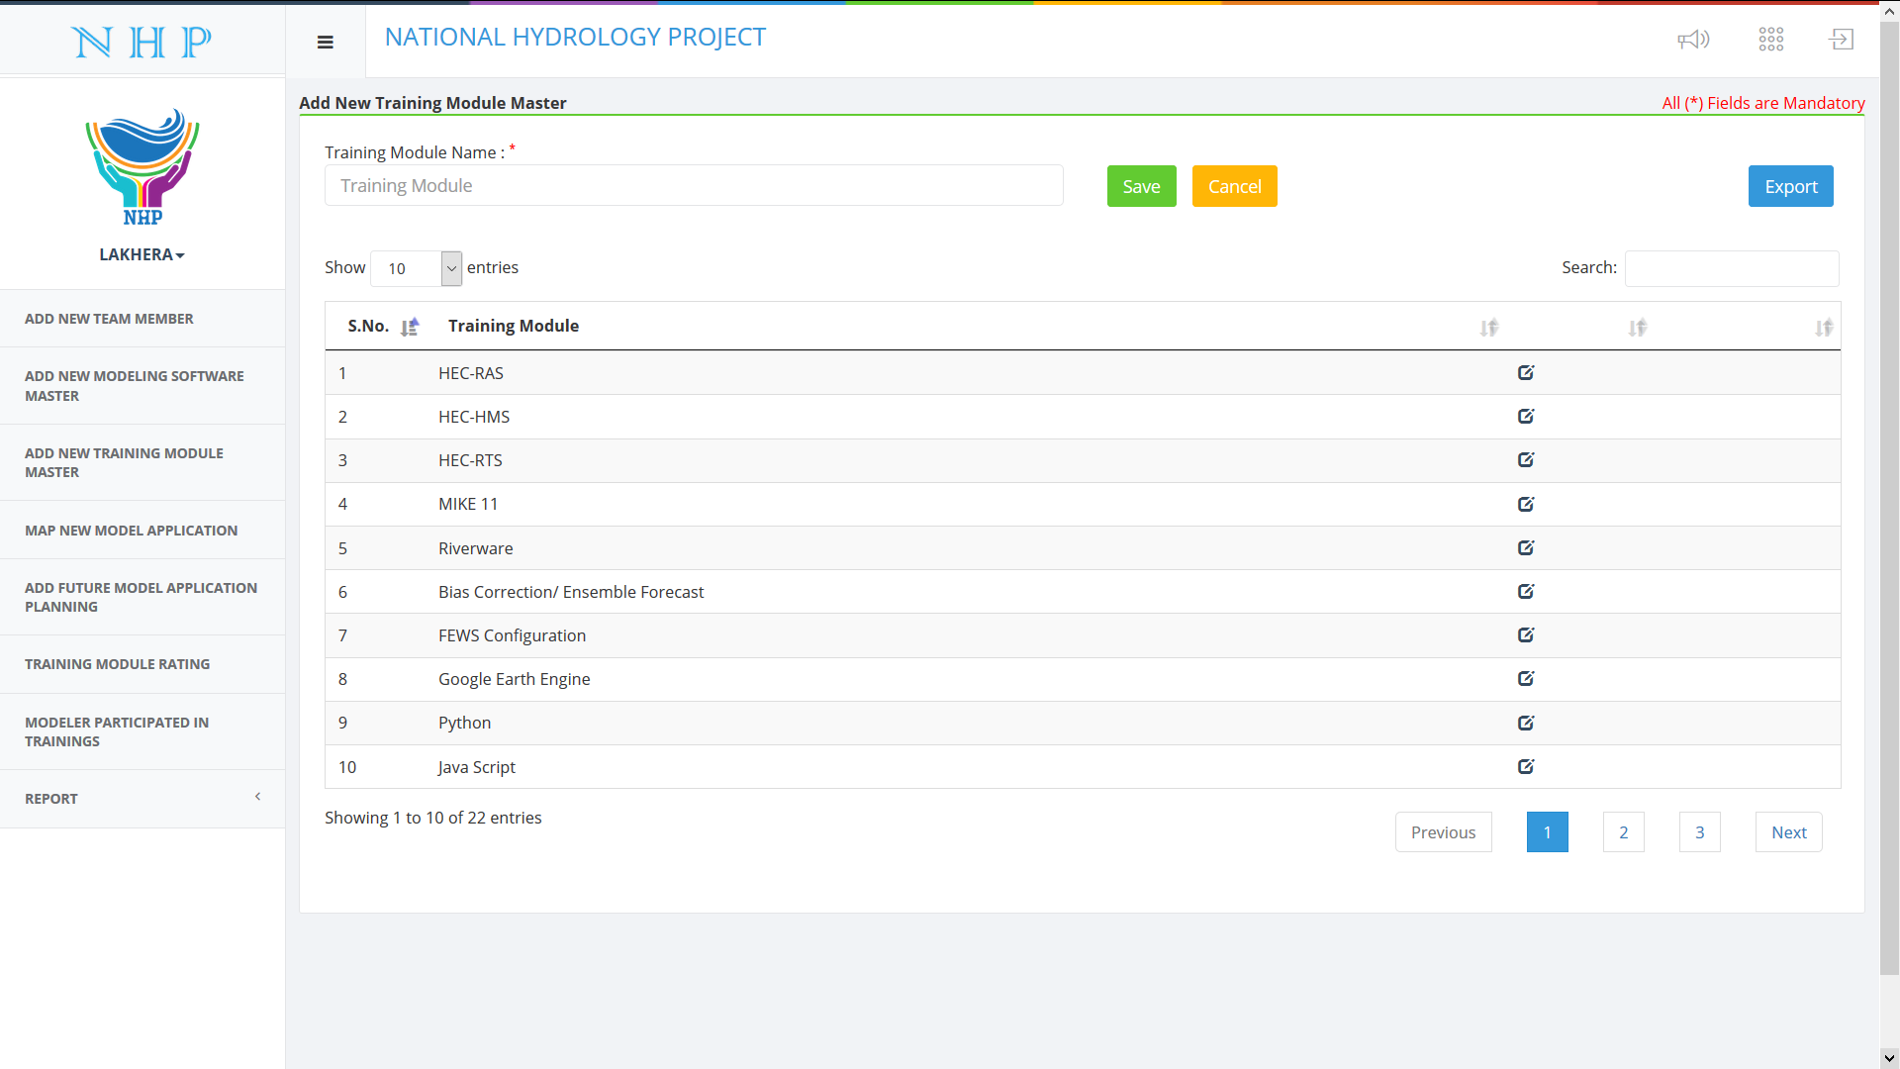
MODELLER - ADD NEW TRAINING MODULE MASTER

Slide 11
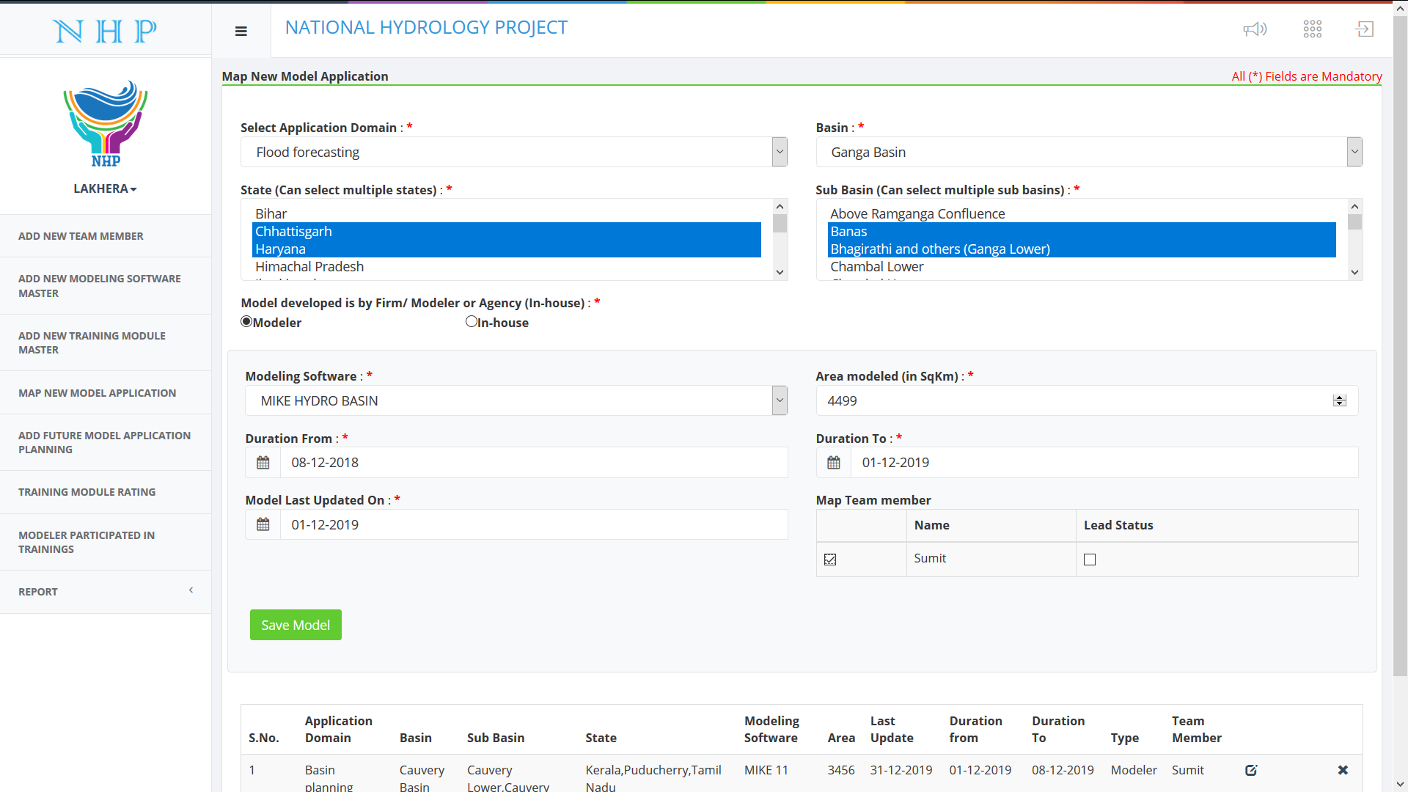
MODELLER - MAP MODEL APPLICATION

Slide 12
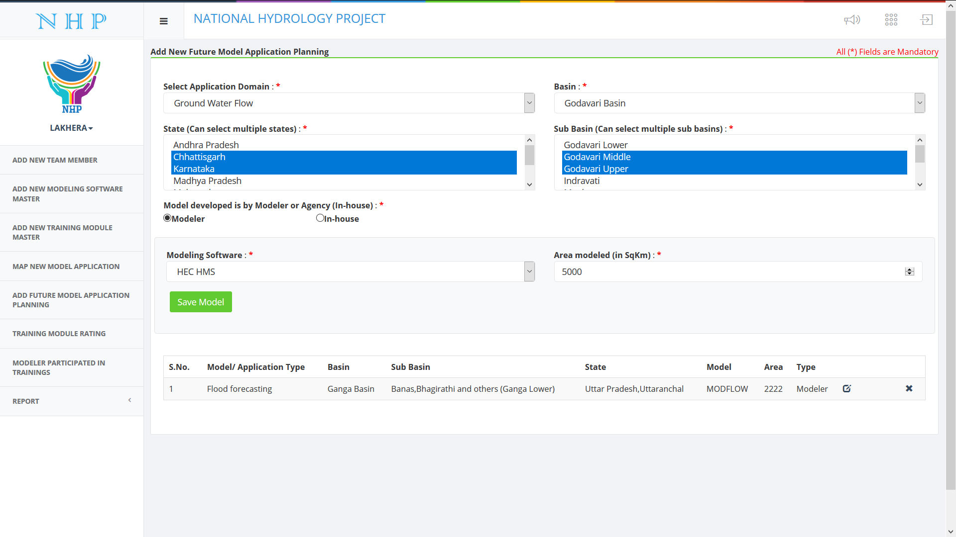
MODELLER - ADD FUTURE MODEL APPLICATION PLANNING

Slide 13
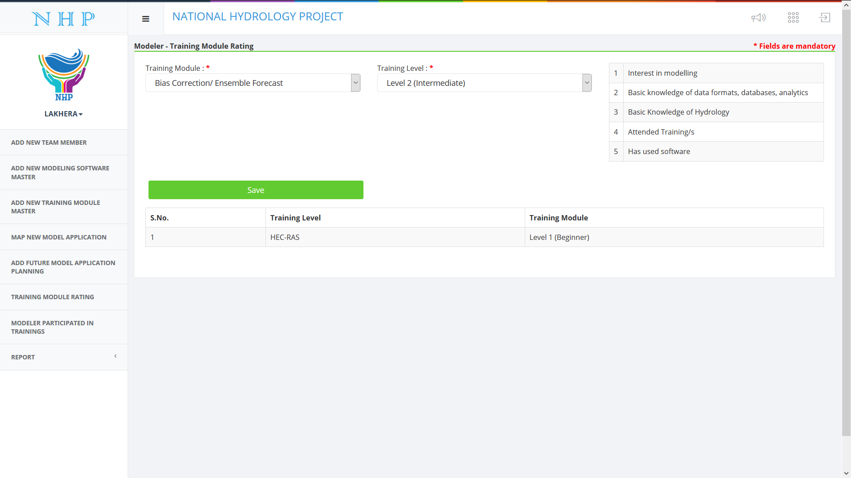
MODELLER - TRAINING MODULE RATING

Slide 14
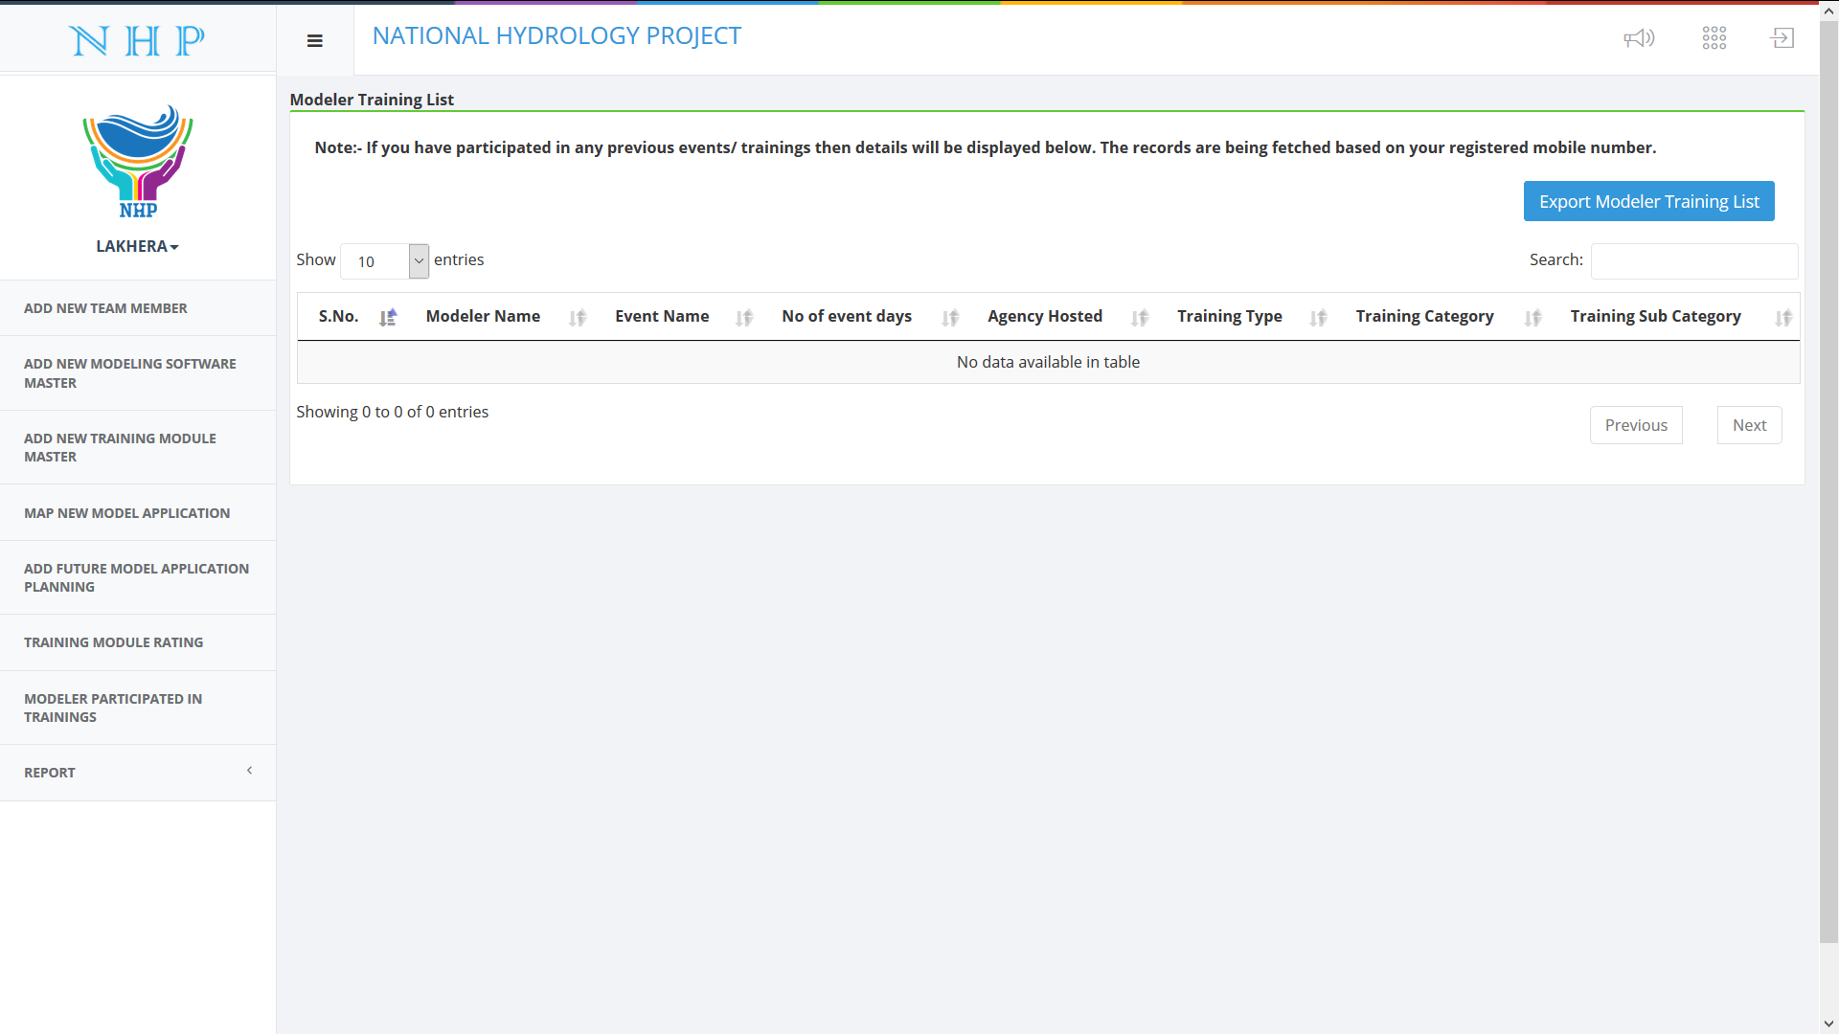
MODELLER - PARTICIPATED IN TRAINING

Slide 15
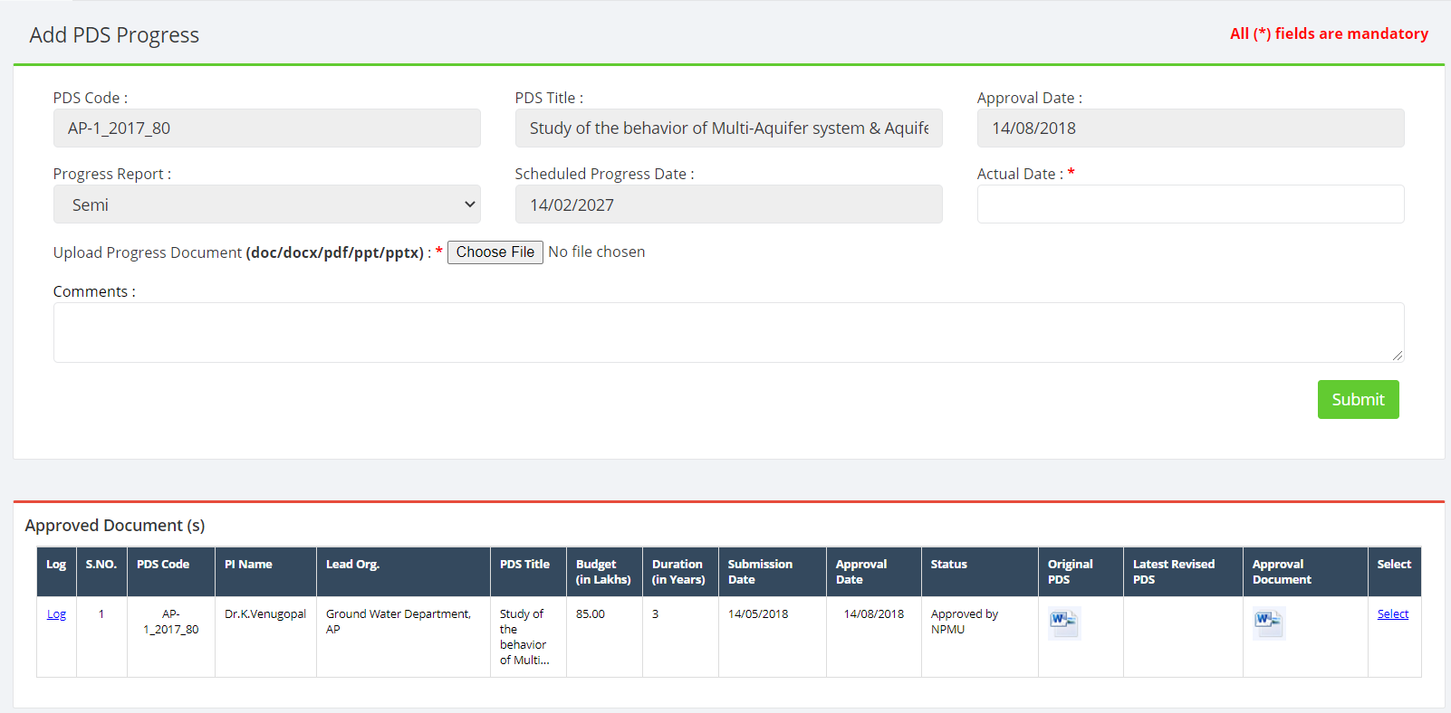
PDS – ADD PDS PROGRESS

Slide 16
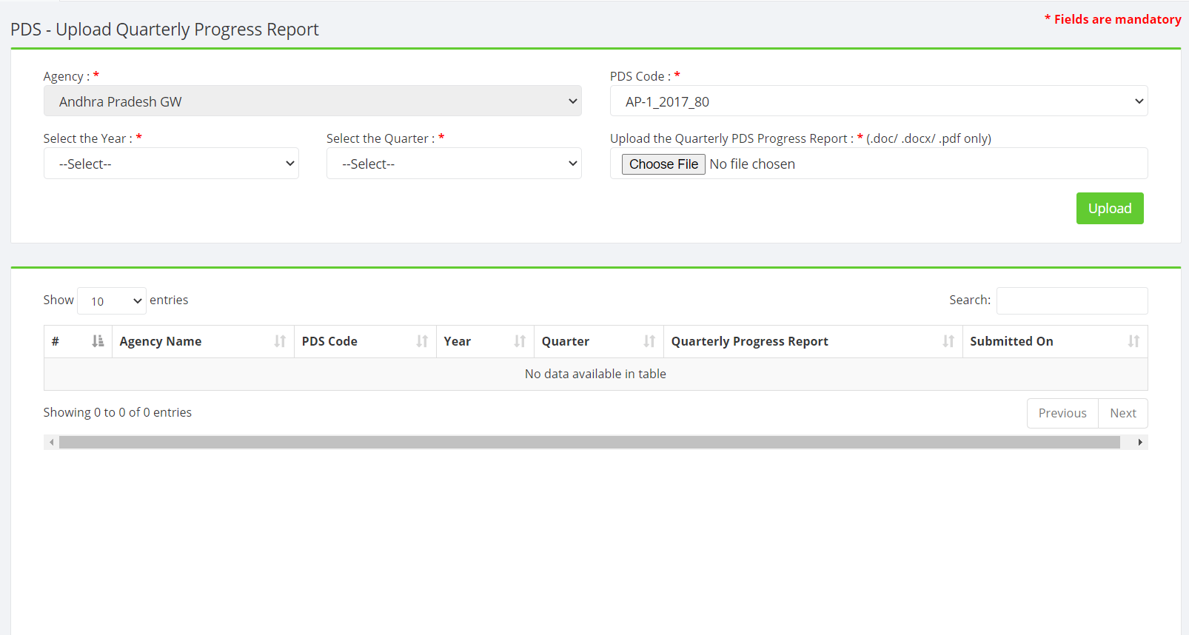
PDS – ADD PDS QUARTERLY PROGRESS

Slide 17
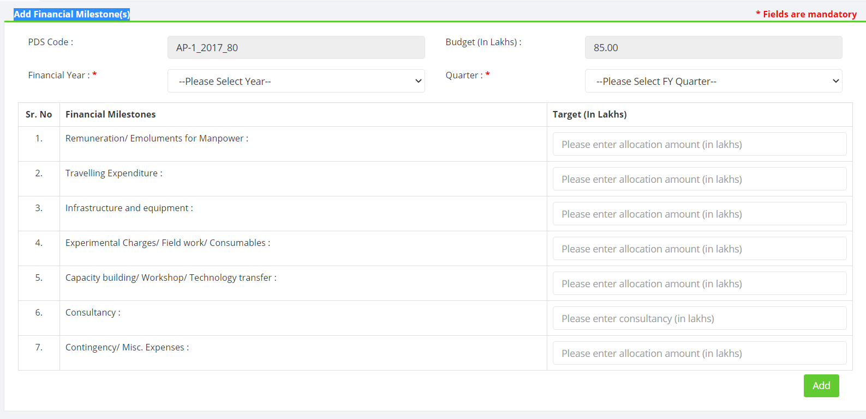
PDS – ADD FINANCIAL MILESTONE

Slide 18
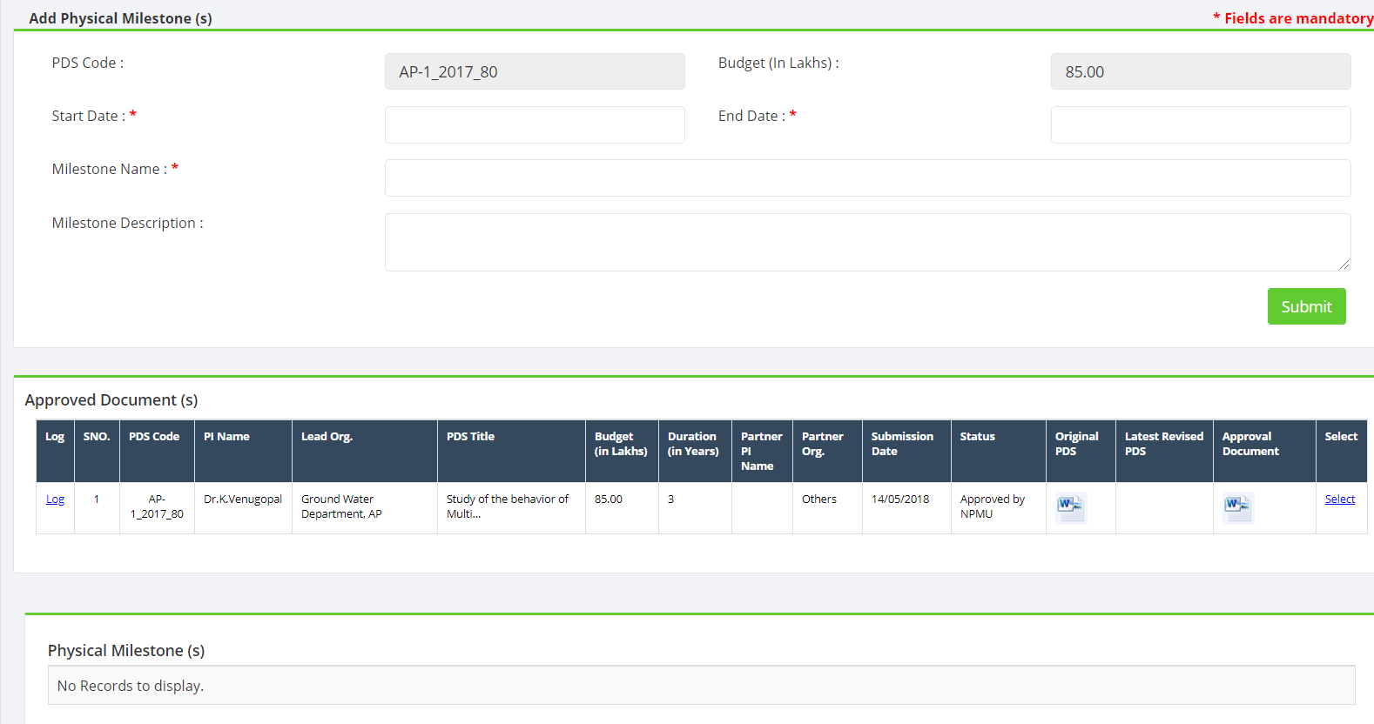
PDS – ADD PHYSICAL MILESTONE

Slide 19
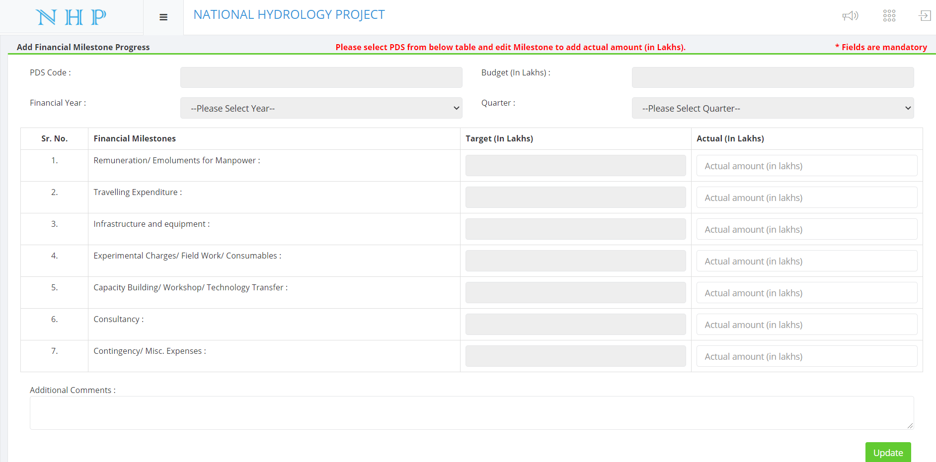
PDS – ADD FINANCIAL MILESTONE PROGRESS

Slide 20
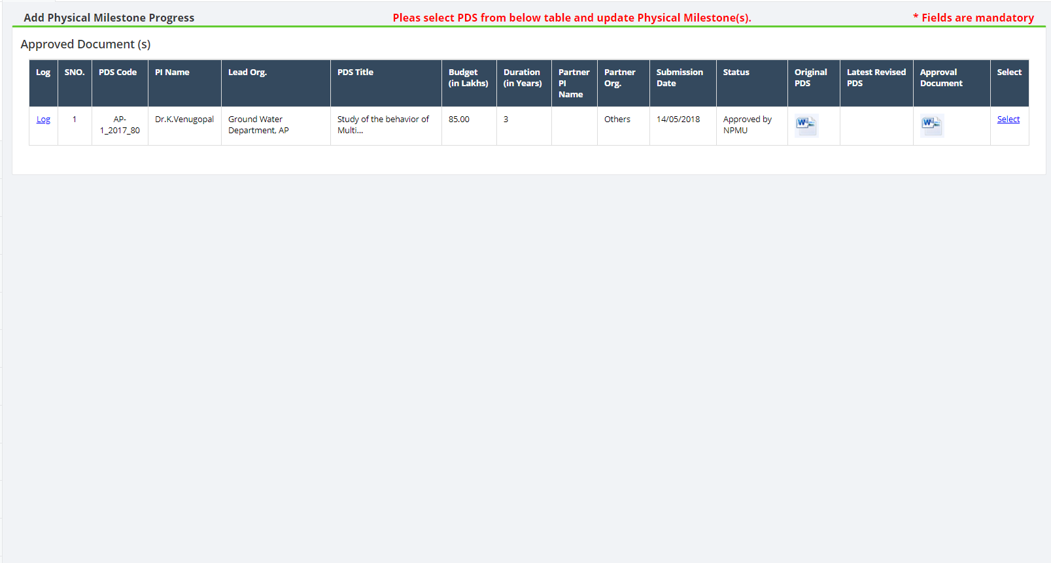
PDS – ADD PHYSICAL MILESTONE PROGRESS

Slide 21
PDS – ADD PHYSICAL MILESTONE PROGRESS

Slide 22
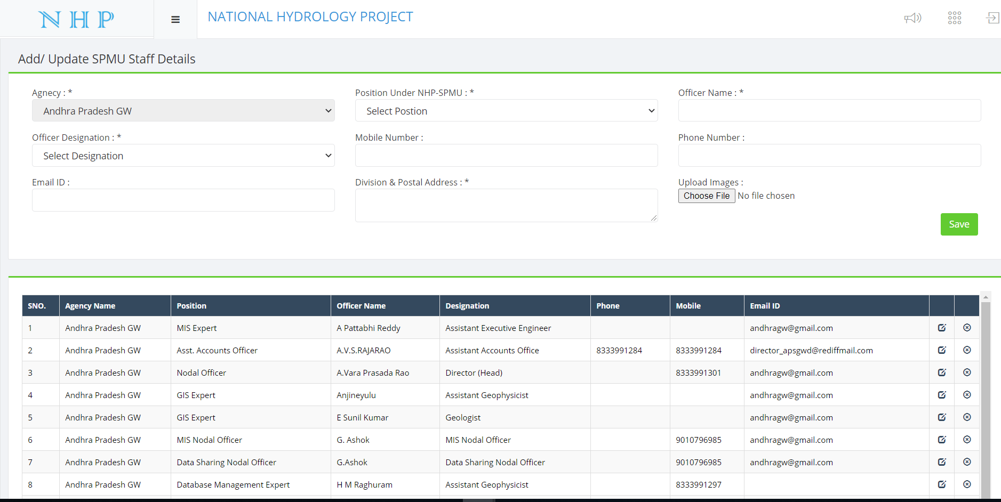
SPMU STAFF MANAGEMENT

Slide 23
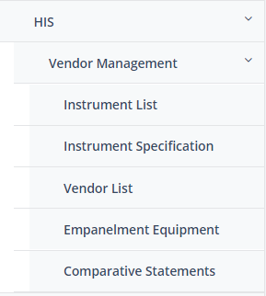
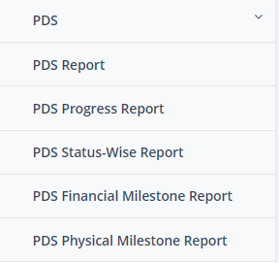
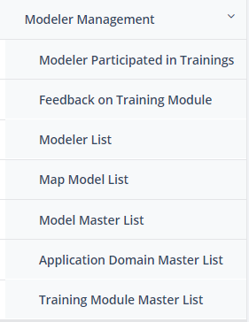
REPORTS

Slide 24
THANK YOU

